Slide 1
Sales Recommendation
Cross-sell and Up-sell

Slide 2
Data cleaning and Preparation
Filtering transactions before 2012
Masking ”Product_Family” to others for less then 50 records
Seats Modification
Company Standardization (23.7k to 21.7k)
If we take only standardized entries we saw better correlation (Sales Analysis)
L1 – 1308 customers and L2 – 114 customers (Sales Analysis)
Grouping based on Seats_modified to represent rating

Slide 3
Models
popularity_model
item_sim_model_cosine
item_sim_model_jaccard
item_sim_model_pearson
factorization_model
factorization_model_als
ranking_factorization_model

Slide 4
Stats
Train Data
32406 observations
20762 customers
47 unique products
Test Data
1536 observations
Note : 13069 data points have only 1 record hence it has been taken into training and that’s the reason for uneven split

Slide 5
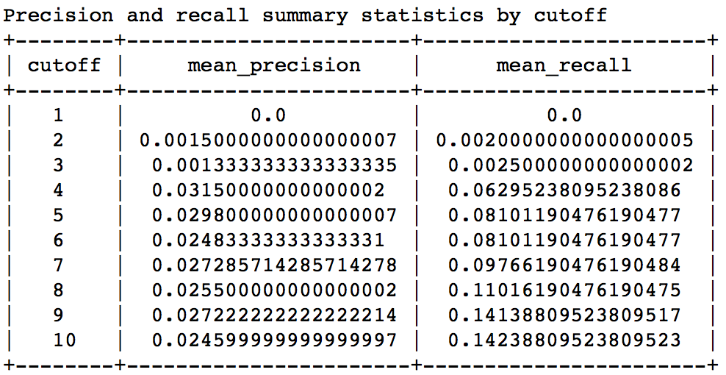
Results-popularity_model
RMSE : 27.77

Slide 6
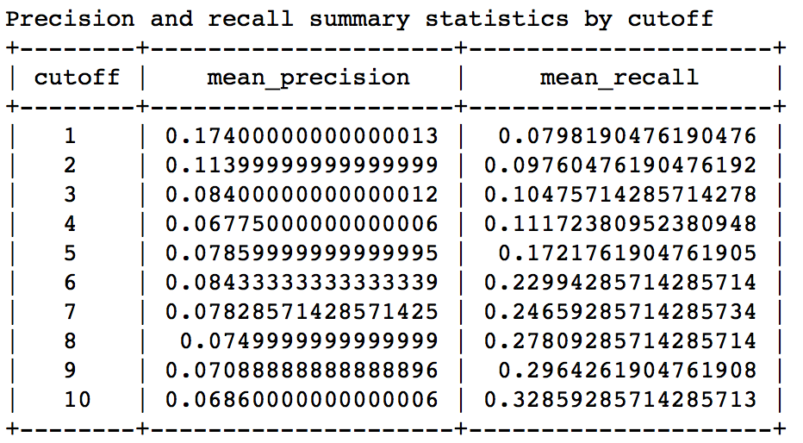
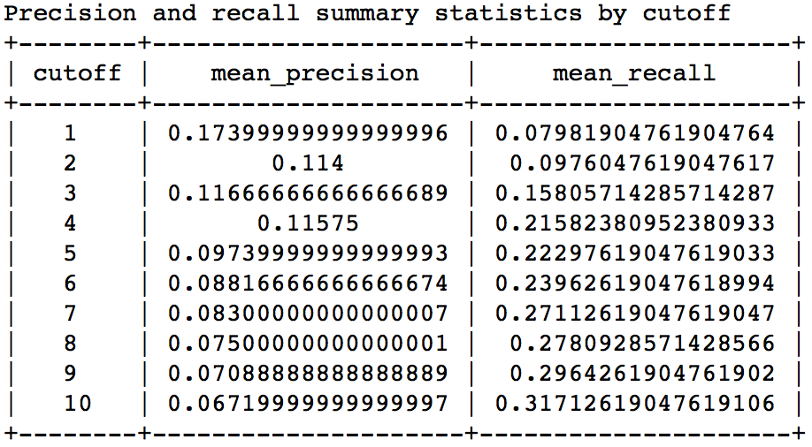
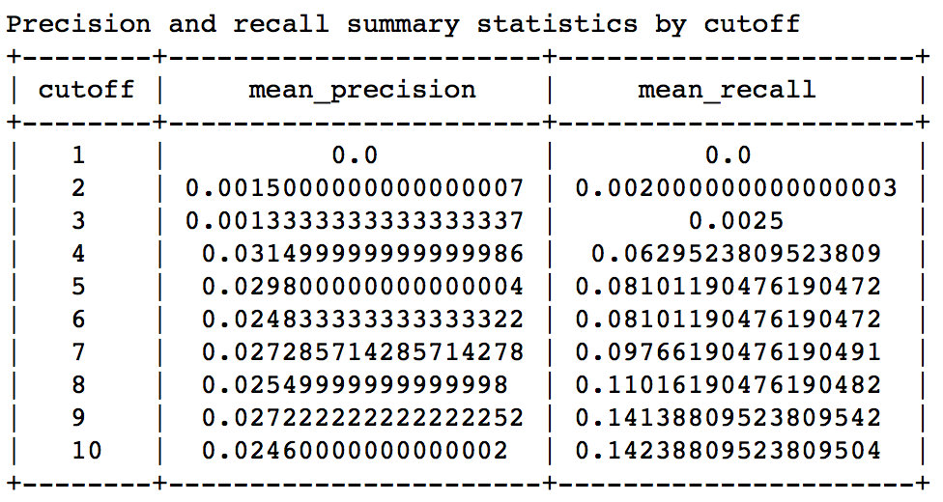
Results-Item Similarity
Pearson
Cosine
Jaccard

Slide 7
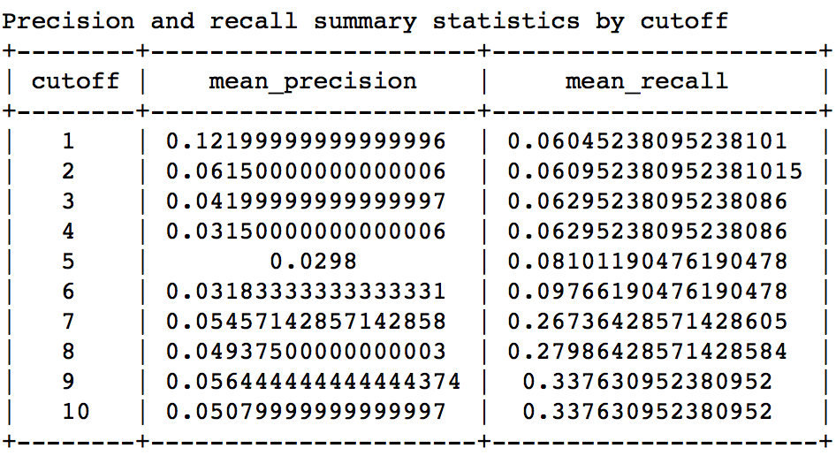
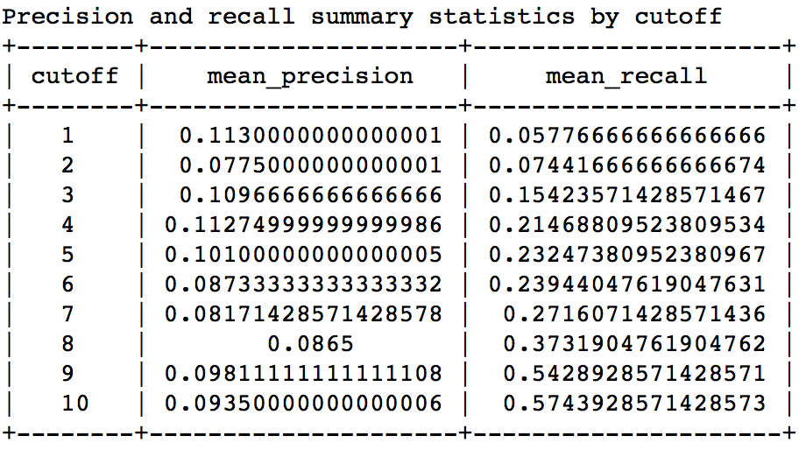
Result-Factorization
Solver - Auto
Solver - ALS

Slide 8
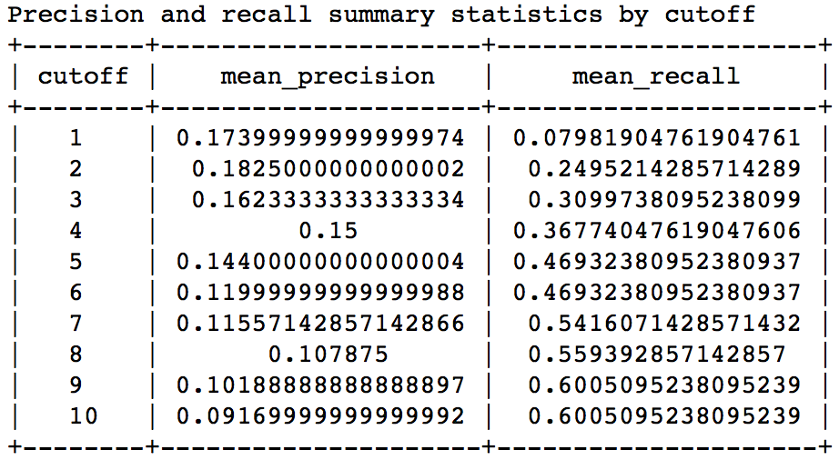
Results-Ranking Factorization

Slide 9
Recommendations – Ranking Factorization
Customer_Name | Product_Family | score | rank
csc | emss | 2.393380906886037 | 1
csc | go | -11.134535047703807 | 2
csc | file director | -17.127401563817088 | 3
csc | ldmg (management gateway) | -19.398855421238963 | 4
csc | datanow | -24.038931104832713 | 5
new_customer | ldms | -23.96848127573115 | 1
new_customer | protect | -31.072754118138377 | 2
new_customer | patch manager | -33.91641638010127 | 3
new_customer | security suite | -37.70766470163447 | 4
new_customer | res uem | -40.23601171701533 | 5

Slide 10
Recommendations – Popularity Model
Customer_Name | Product_Family | score | rank
csc | xtraction oem royalty | 139.5 | 1
csc | ht oem | 24.11764705882353 | 2
csc | shavlik oem royalties | 23.916666666666668 | 3
csc | patch manager | 11.826443202979515 | 4
csc | heat 2014 saas | 11.041666666666666 | 5
new_customer | xtraction oem royalty | 139.5 | 1
new_customer | ht oem | 24.11764705882353 | 2
new_customer | shavlik oem royalties | 23.916666666666668 | 3
new_customer | patch manager | 11.826443202979515 | 4
new_customer | heat 2014 saas | 11.041666666666666 | 5

Slide 11
Similar Products – Ranking Factorization
Product_Family | similar | score | rank
ldms | asset manager | 2.0252833366394043 | 1
ldms | ht oem | 1.6402955055236816 | 2
ldms | ldim (inventory manager) | 1.6044597625732422 | 3
ldms | it asset manager | 1.2586250305175781 | 4
ldms | discovery | 0.38457155227661133 | 5

Slide 12
Similar Users – Ranking Factorization
Customer_Name | similar | score | rank
csc | siemens ag | 1.0 | 1
csc | arsenal football club | 1.0 | 2
csc | ascena retail group, inc. | 1.0 | 3
csc | gordon food service | 1.0 | 4
csc | gonzalez production systems, inc. ... | 1.0 | 5
csc | salt lake county government center ... | 1.0 | 6
csc | hallmark cards | 1.0 | 7
csc | avalon bay communities | 1.0 | 8
csc | azienda ospedaliera | 1.0 | 9
csc | hansecom | 1.0 | 10

Slide 13
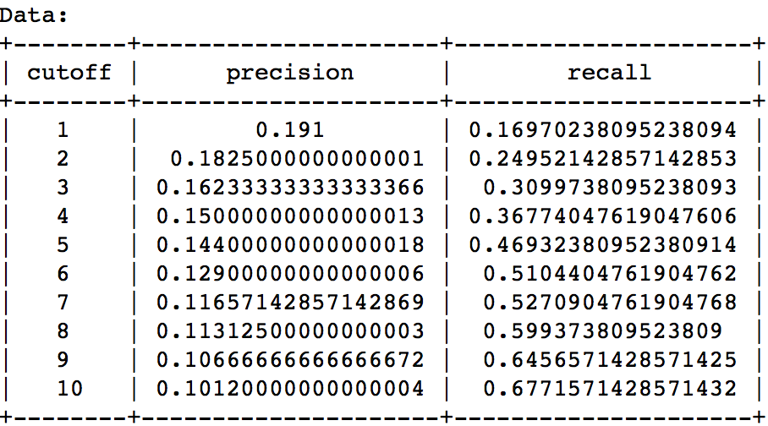
Parameter Tuning – Ranking Factorization
Number of factors : 47
Regularization – 1e-4

